Slide 1
Penetration Testing
James Walden
Northern Kentucky University

Slide 2
Topics
What is Penetration Testing?
Rules of Engagement
Penetration Testing Process
Map the Application
Analyze the Application
Exploit the Application

Slide 3
What is Pen Testing?
Security testing is the process of providing evidence of how well an application satisfies its security requirements.
Penetration testing is a method of security testing, in which testers simulate the efforts of attackers.

Slide 4
What is Pen Testing?
Penetration testing evaluates the security of software in its deployed environment.
Effect of firewalls
Deployed cryptographic libraries
Effect of other security services and processes
Abuse Cases
Risk
Analysis
Code Reviews +
Static Analysis
Security
Testing
Penetration
Testing
Security
Operations
Requirements
Design
Coding
Testing
Maintenance

Slide 5
Purposes of Pen Tests
Identify vulnerabilities that may be difficult or impossible to detect in design or code reviews.
Determine the feasibility of certain attacks.
Assess the impact of potential attacks.
Test the ability of system to detect attacks.
Provide evidence to support increased investments in security.

Slide 6
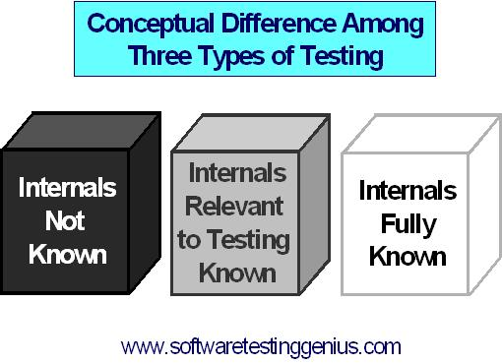
Black, White, Grey Box Testing
Notes:
http://www.softwaretestinggenius.com/articalDetails?qry=404

Slide 7
Rules of Engagement
Which systems are being tested?
Deployment or development?
Web, DB, others?
What tests will be performed?
Read-only
Read-write
DoS
When will the tests be performed?
Who to contact if tests cause problems?

Slide 8
Penetration Testing Process
Map the Application
Analyze the Application
Exploit the Application

Slide 9
Map the Application
Manual following of all links with browser.
Automatic mapping with a spider.
User-driven spidering of site.
Finding hidden content.

Slide 10
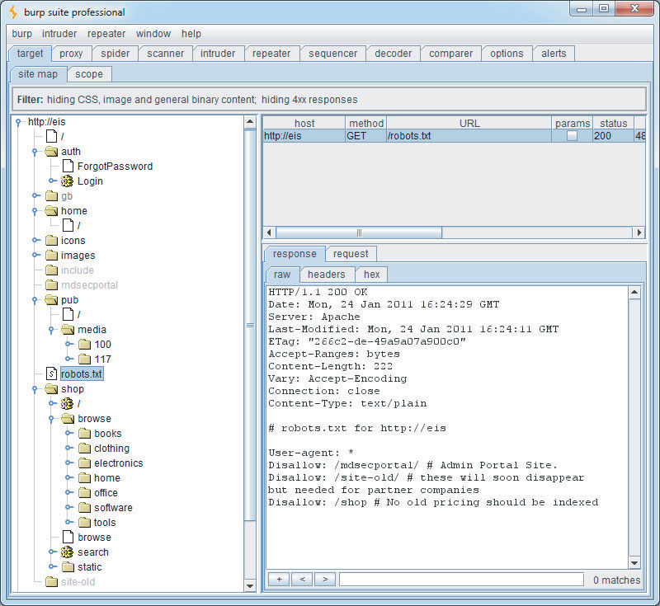
Automatic Mapping

Slide 11
Automatic Mapping Limitations
Difficult to parse complex JavaScript menus.
Unable to see links in many types of objects, like Flash or Java.
Spider may not fill out every form field correctly to get to next step in processes like user registration, billing, etc.
Form-based navigation may use the same URL for each step, causing spider to ignore multiple requests to a URL already cached.
Spider may terminate its session by selecting Logout link before map is complete.

Slide 12
User-Directed Spidering
Point browser at proxy tool.
User browses through site as normal.
User handles authentication and filling out complex forms.
Proxy builds map of site.
Parses out all links from HTML to add to map, but does not follow them automatically.

Slide 13
Finding Hidden Content
Check HTML for comments, hidden fields
+
Try URLs that are not links to find
Backup files, e.g. end in ~ or .bak
View source code
Possibility find db login credentials
Backup archives of entire site
Admin directories
Access admin functionality without credentials
Log files
May contain credentials or session IDs

Slide 14
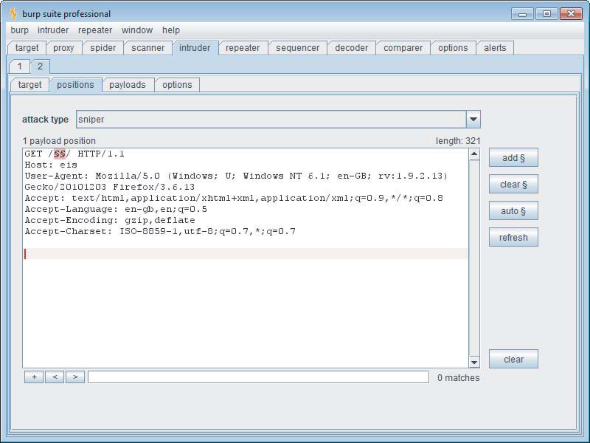
Finding Hidden Content

Slide 15
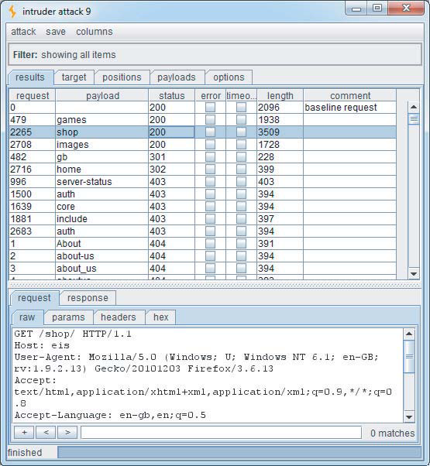
Finding Hidden Content

Slide 16
Analyze the Application
Application core functionality.
Peripheral functionality, like administrative, logging, and redirection services.
Security mechanisms, including
Authentication and password management.
Access control.
Session management.
Client-side technologies (JS, cookies, etc.)
Server-side technologies (PHP/JSP, DB, etc.)
All entry points where application accepts input.

Slide 17
Identifying Entry Points
Every URL up to the query string marker
Every parameter within URL query string
Every parameter submitted within the body of a POST request
Every cookie
Every HTTP header that the app may process, especially User-Agent, Referer, Host, and Accept headers.

Slide 18
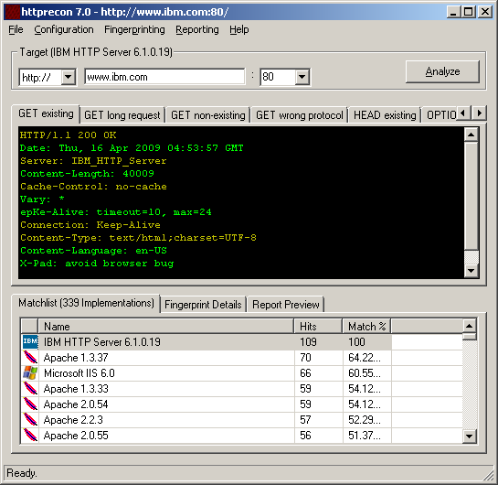
HTTP Fingerprinting

Slide 19
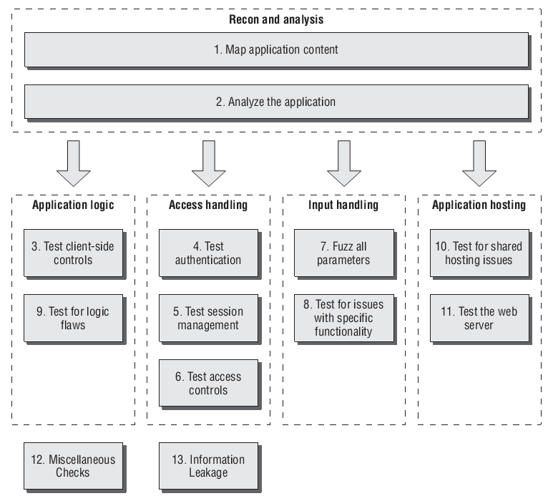
Exploiting the Application
Notes:
Figure 21-1 from Web Application Hacker’s Handbook, 2/e

Slide 20
Fuzz Testing
Data Set Template
Create a template based on the protocol used by the application.
Ex: GET /query?[ ]&[ ] HTTP/1.1
Value Manipulation
Replace template placeholders with random values from data set (numeric, alphabetic, etc.)
Application Monitoring
Send data and monitor application behavior.
Does app crash, error, send unusual responses?

Slide 21
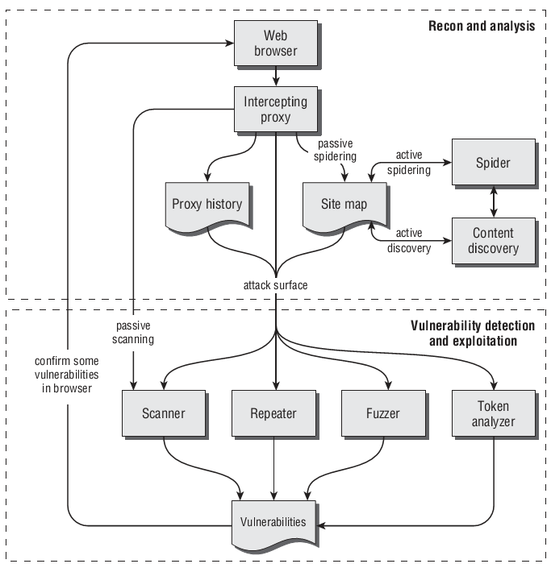
Web App Pen Test Work Flow
Notes:
Figure 20-14 from Web Application Hacker’s Handbook, 2/e

Slide 22
References
CERT, Black Box Security Testing Tools, https://buildsecurityin.us-cert.gov/bsi/articles/tools/black-box/261-BSI.html, 2009.
Patrick Engebretson, The Basics of Hacking and Penetration Testing, Syngress, 2011.
NIST, Technical Guide to Information Security Testing and Assessment, NIST Special Publication 800-115, 2008.
PCI Security Standards Council, PCI DSS Requirements and Security Assessment Procedures, v1.2, 2008.
Dafydd Stuttart and Marcus Pinto, The Web Application Hacker’s Handbook 2nd edition, Wiley, 2011.
Kenneth R. van Wyk, Adapting Penetration Testing for Software Development Purposes, https://buildsecurityin.us-cert.gov/bsi/articles/best-practices/penetration/655-BSI.html, 2008.

